Slide 1
Classification of Matter
C.4.D classify matter as pure substances or mixtures through investigation of their properties.

Slide 2
Table of Contents
Slide 3 Composition of Matter
Slide 4 & 5 Pure Substances
Slide 6 Mixtures
Slide 7 Homogeneous Mixtures
Slide 8 Heterogeneous Mixtures
Slide 9-11 Mixture Separation Techniques
Slide 12 Review
Slide 13 Practice

Slide 3
Composition of Matter

Slide 4
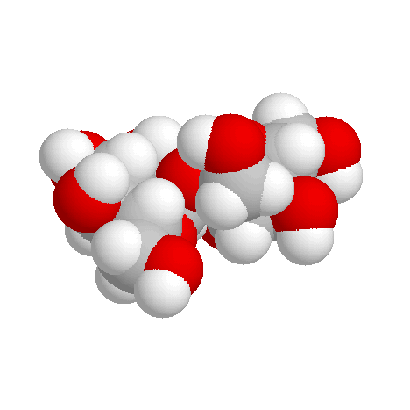
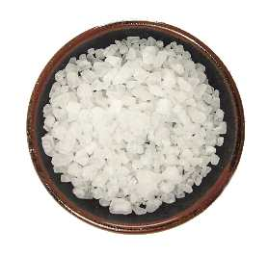
Pure Substances
every sample has same:
characteristic properties
composition
are made of:
one type of atom: element
Ex: iron, gold, oxygen
2 or more types of atoms: compound
Ex: salt, sugar, water

Slide 5
Which are pure substances?

Slide 6
Mixtures
blend of 2 or more types of matter
each component keeps its own identity and properties
the components are only physically mixed
can be separated using physical means
properties of the mixture are a combination of the component’s properties

Slide 7
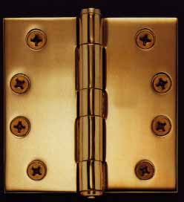
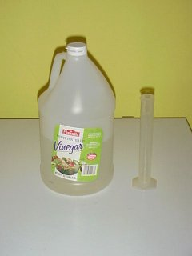
Homogeneous Mixtures
also called solution
uniform in composition
no visible parts
Ex:
vinegar
clear air
salt water
brass

Slide 8
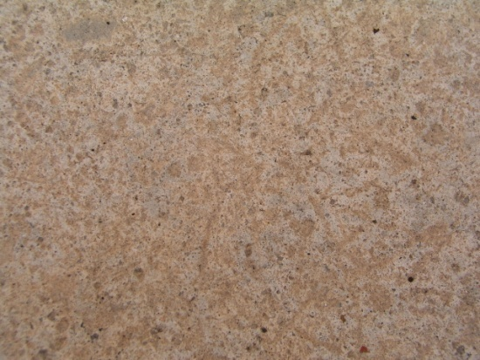
Heterogeneous Mixtures
not uniform in composition
visible parts
Ex:
soil
concrete
blood
chocolate chip cookies
sand in water
iced tea with ice

Slide 9
Mixture separation Techniques
Filtration- solid part is trapped by filter paper and the liquid part runs through the paper
Vaporization- where the liquid portion is evaporated off to leave solid

Slide 10
Mixture separation Techniques
Decanting- when liquid is poured off after solid has settled to bottom
Centrifuge- machine that spins a sample very quickly so that components with different densities will separate

Slide 11
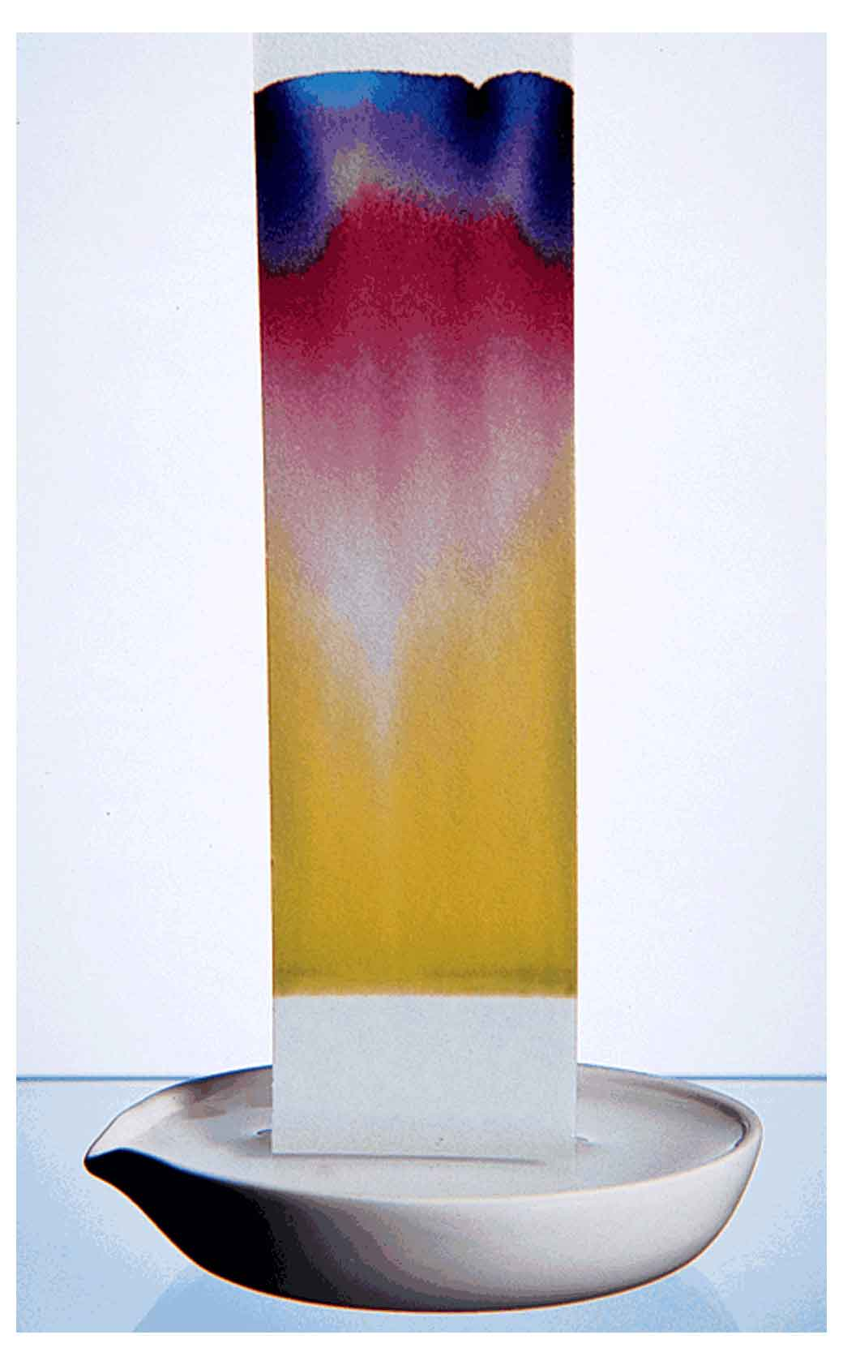
Mixture separation Techniques
Paper Chromatography- used to separate mixtures because different parts move quicker on paper than other

Slide 12
Review

Slide 13
Practice Determine whether each of the following is element, compound, homogeneous mixture or heterogeneous mixture.
air
zinc
chlorine
granite
aluminum
sugar in water
blood
sucrose
stainless steel
sodium chloride
brass
whole milk
apple
table salt
soft drinks
vinegar
concrete
sodium
baking soda (NaHCO₃)
gravel

